Slide 1

Library Management System
Submitted By:
Rineesh M S
Mohammed Nihal
Muhammed Sinan C P
Athulya C

Slide 2
Library Management System
This presentation documents the Library Management System project. The system facilitates book management, user authentication, and borrowing functionalities. Built using Python and MySQL, it ensures secure access and smooth operations.

Slide 3

Gratitude and Support
1
We extend our deepest thanks to our mentors. Their wisdom shaped our direction and approach.
2
To our teammates, thank you. Your collaboration and dedication were pivotal.
3
We acknowledge our institution. Providing the resources was essential to this project's success.

Slide 4
Project Overview
Streamlined Book Management
Secure User Authentication
Simplified Borrowing
Ensure only authorized users access the system.
Make it easier to borrow and return books.
Efficiently track and manage the library's collection.

Slide 5




Introduction to the System
Purpose
Importance
Problem Statement
To efficiently manage library resources and user access.
Ensuring smooth operations and data security.
Address inefficiencies in manual library processes.

Slide 6




Addressing the Challenges
Inefficient Tracking
Manual processes led to errors.
Limited Access
Restricted user access to resources.
Data Security
Ensuring the security of sensitive data.

Slide 7
System Requirements
Functional
Non-Functional
User registration
Security
Book cataloging
Performance
Borrowing/returning
Usability

Slide 8
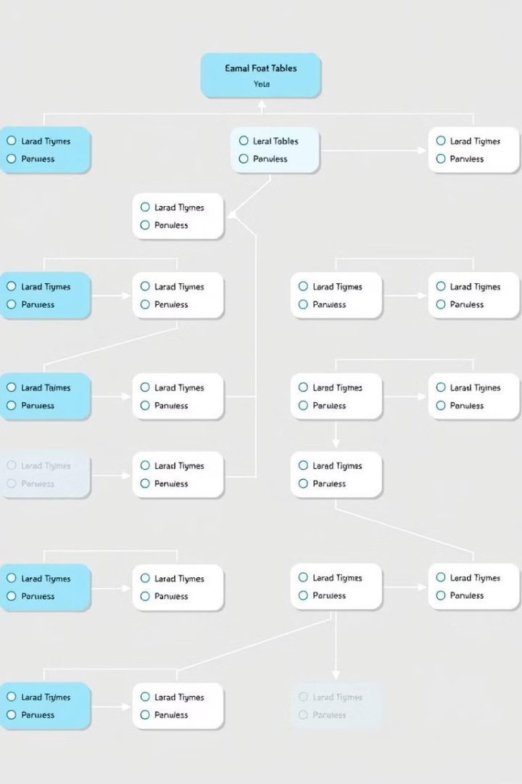
Database Design
1
Entities
Users, books, transactions.
2
Relationships
One-to-many, many-to-many.
3
Attributes
Details for each entity.

Slide 9
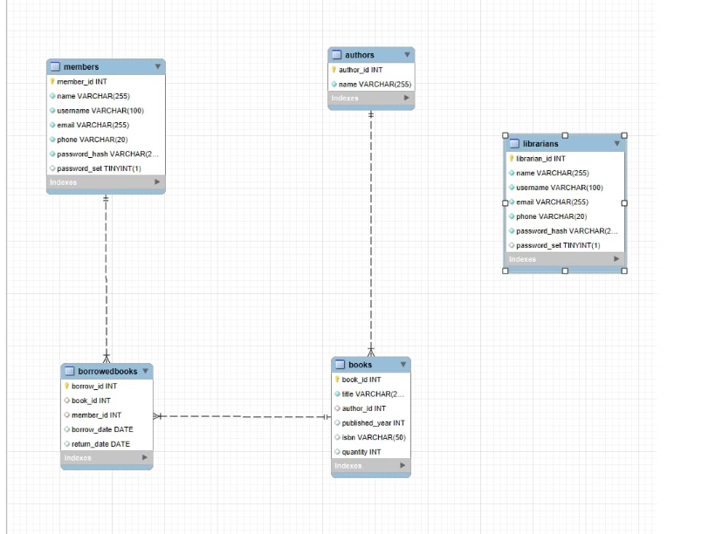
Visualizing Data Flow

Slide 10
Outcomes and Analysis
Improved Efficiency
Enhanced Security
Faster book tracking and borrowing.
Secure user authentication protocols.
The Library Management System enhances operational efficiency. It improves data security and accessibility. It also sets the stage for future enhancements and scalability.

Slide 11
Thank You…

